Slide 1

COVID-19 MONITOR Europe and central Asia
[Unless otherwise specified, data is as of May 15th]

Slide 2
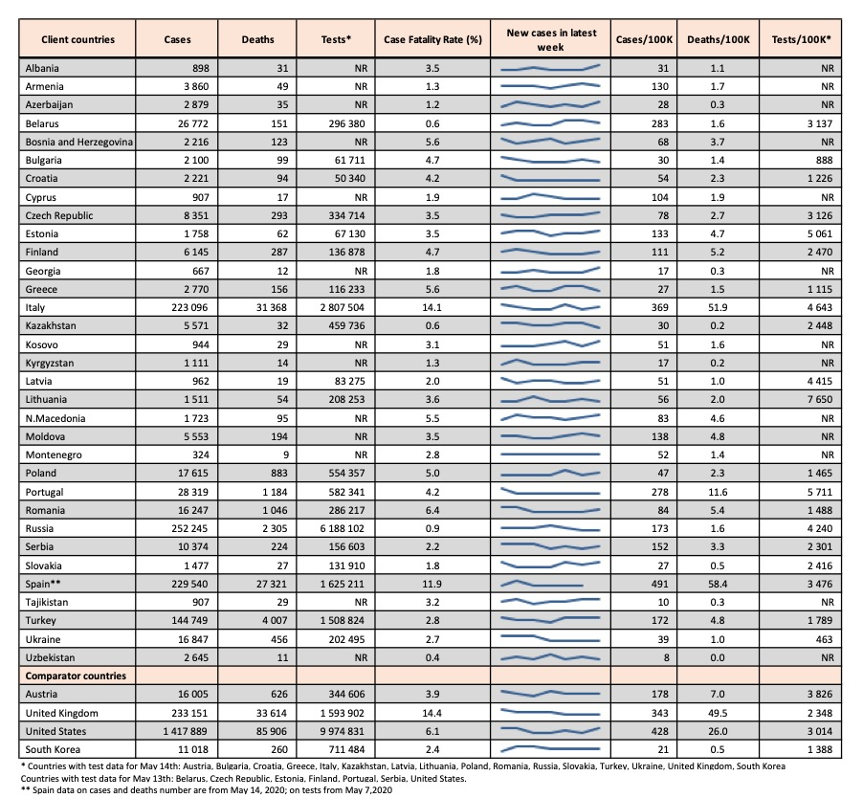
Total cases, case fatality rates, and testing
Cases per 100,000 population range from 8 in Uzbekistan to 361 in Italy and 491 in Spain.
Case fatality rates are below 5% in most client countries, with higher rates seen in Italy (14.1%) and Spain (11.9%).
A significant number of countries in the region do not report accurate data on testing (NR).
Units for testing are also not consistent due to reporting differences across reporting countries (person vs. tests).
Among countries with testing data, there is variation in testing rates (per 100,000 population) from 463 per 100,000 in Ukraine to 7,650 in Lithuania.
Testing rates may partially explain variation in reported cases.

Slide 3
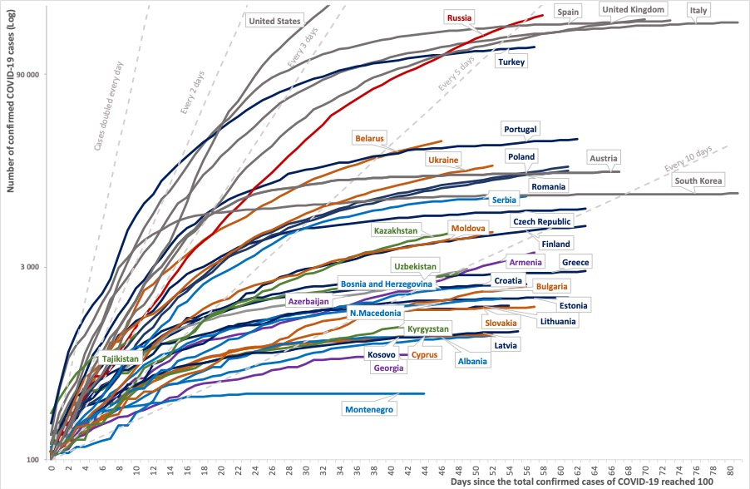
Total reported cases in client and comparator countries
This chart plots trajectories in reported total cases for client countries and four comparators, since reporting the 100th case: Austria, United States, United Kingdom, and South Korea.
Notable are the trajectories for Russia and Turkey, where the doubling rates for total cases are between 5 and 7 days.
The doubling rate for cases appears to be increasing across the region, indicating a slowdown in spread of the virus.
Notes:
Restricted to countries with ≥ 100 cases.

Slide 4
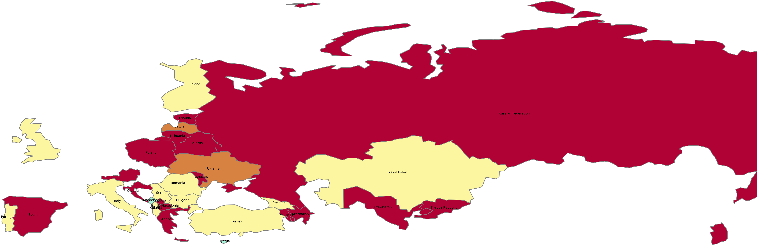
Most recent two-week span: percent change in new cases per 100,000 population
This map plots the change in incidence of cases (in %) between the current week (May 9th to 15th) and the preceding week (May 2nd to 8th).
Case incidence is accelerating in a few countries, with dramatic increases in Russian Federation (6%).
With easing of restrictions, case incidence also increased Spain (9%) and Greece (6%) to a lesser extent.
Notably, Italy has seen a 30% slowing in new cases.
These increases should be interpreted in light of the absolute case count.
Color | Key | Countries
 | -110 to – 50: Dramatic slowing of spread | Montenegro, Cyprus.
 | -50 to -5: Spread slowing | Bulgaria, Turkey, Albania, Portugal, Romania, Italy, Kazakhstan, Finland, Georgia, Serbia, etc.
 | -5 to 5: Spread contained | Ukraine, Latvia.
 | 5 to 100: Spread accelerating | Greece, Russian Federation, Belarus, Spain, Uzbekistan, Azerbaijan, Croatia, Lithuania, North Macedonia, etc.

Slide 5
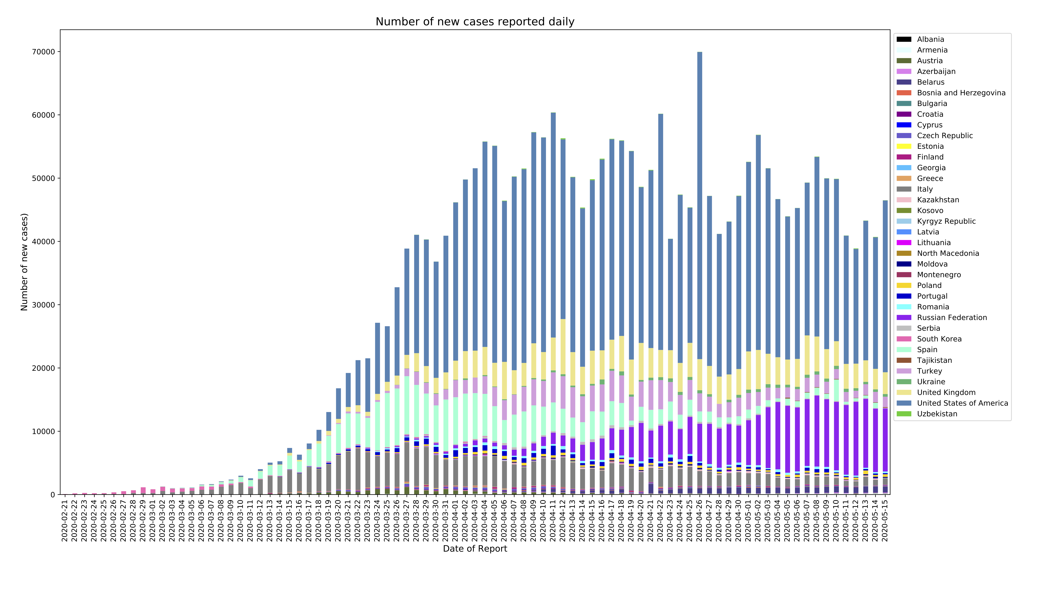
Number of new cases reported daily per 100,000 population
​​This chart plots case incidence per 100,000 population between February 21st and May 15th among client countries.
The chart includes data for four comparator countries: Austria, United States, United Kingdom, and South Korea.
Notable is the growth in new cases in Russia in absolute terms.
Case incidence is decreasing in Italy, Spain and Turkey.

Slide 6
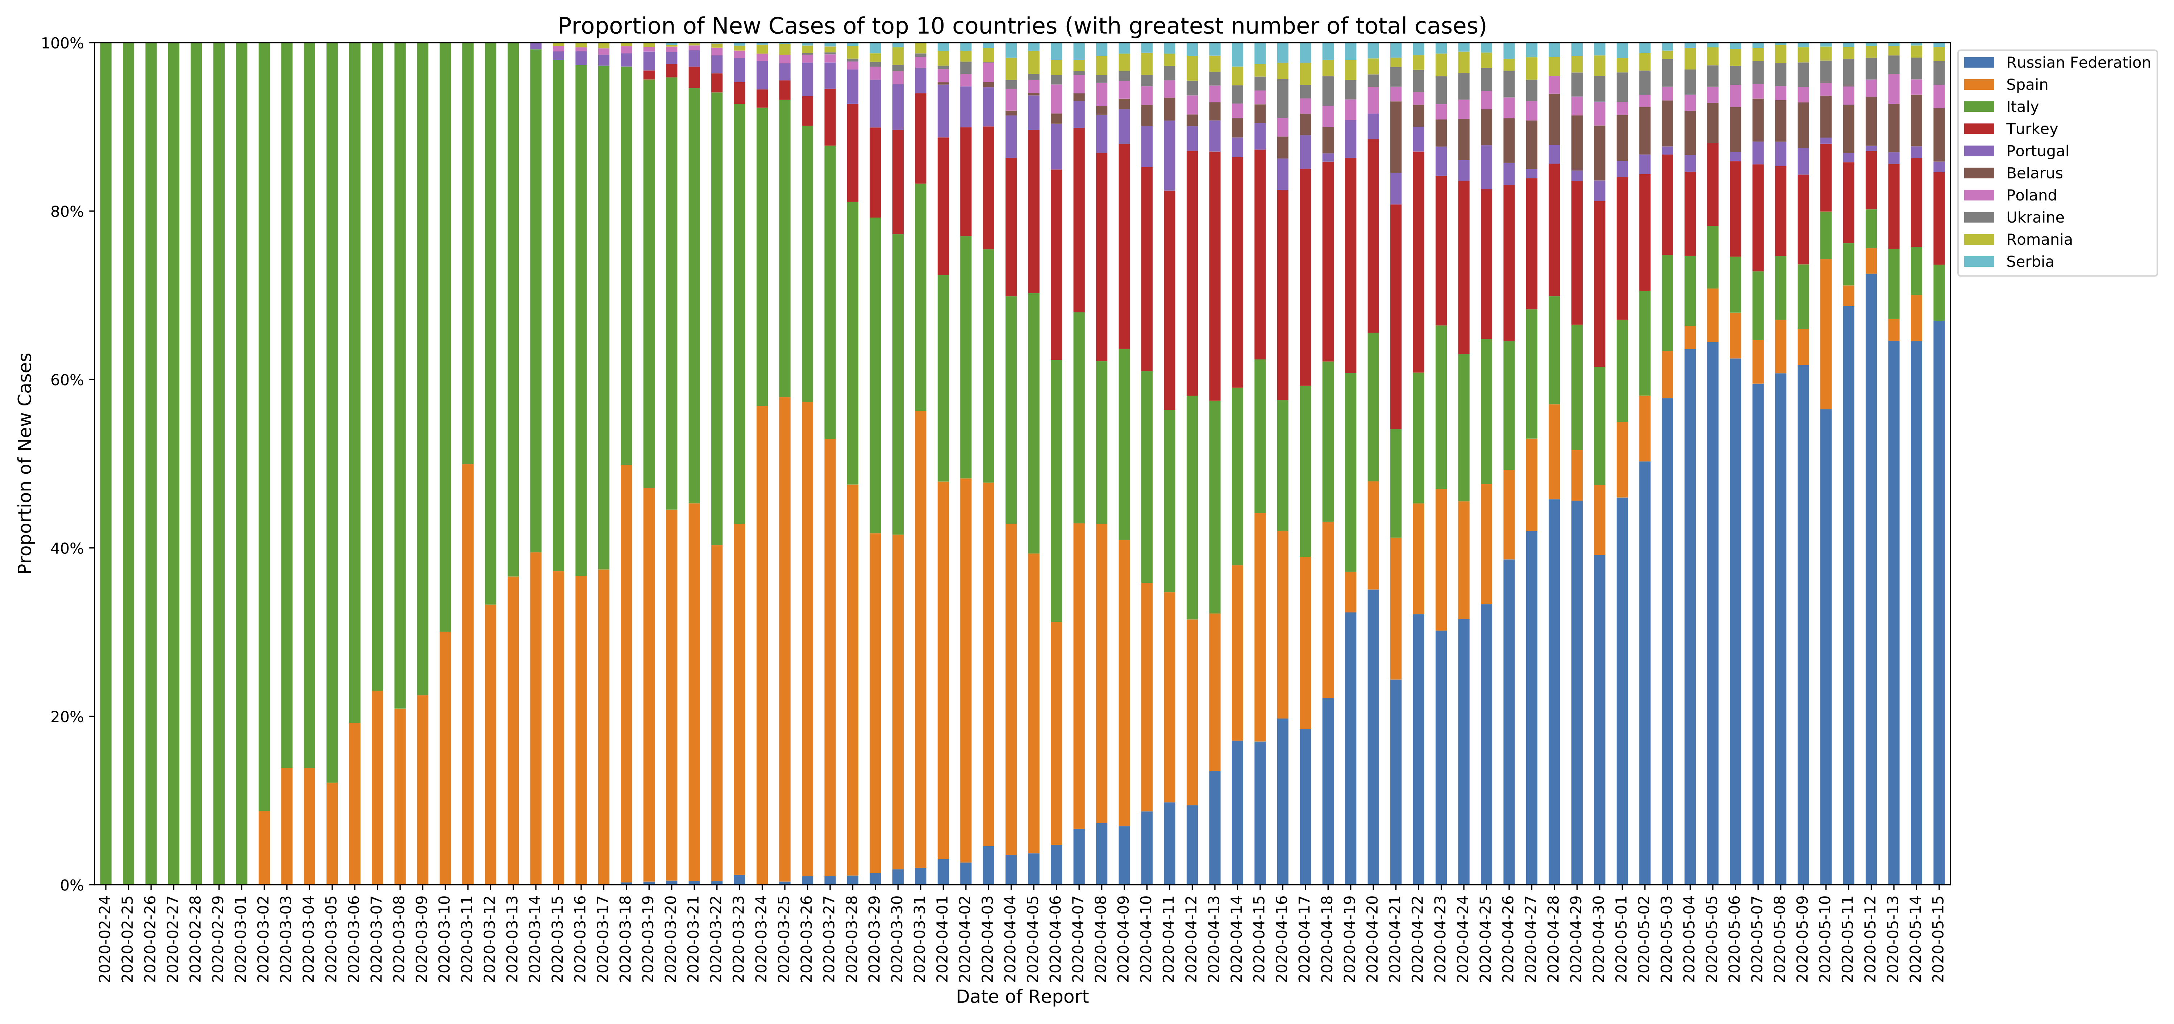
Proportion of new cases in 10 client countries with the highest total number of cases
​
The percentage of new cases in Italy, Spain and Turkey among the top 10 countries are decreasing overall.
The percentage of new cases in Russian Federation and, to a lesser extent, Belarus is increasing.​
​​

Slide 7
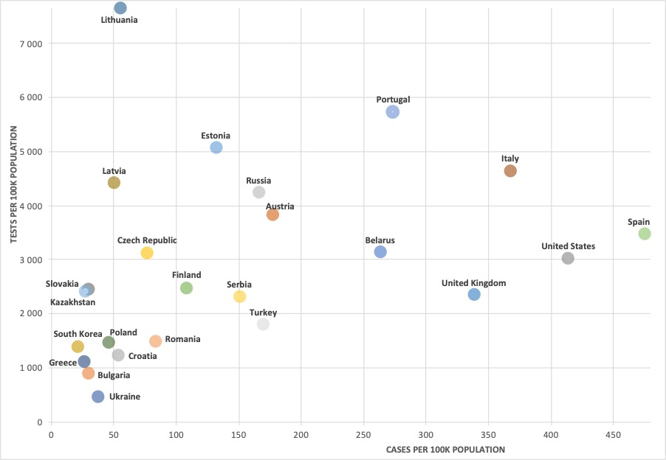
Total cases and tests per 100,000 population
Given the potential for undertesting to limit reported cases, this chart plots total cases and test per 100,000 population for client countries and four comparators: Austria, United States, United Kingdom, and South Korea.
The cluster of countries in the bottom left-hand corner are relatively low-testers, which may explain, in part, the lower case incidence, as in Ukraine, Bulgaria, Croatia, Poland, and Romania.
Countries with data for May 14th:Austria, Bulgaria, Croatia, Greece, Italy, Kazakhstan, Latvia, Lithuania, Poland, Romania, Russia, Slovakia, Turkey, Ukraine, United Kingdom, South Korea.
Countries with data for May 13th: Belarus, Czech Republic, Estonia, Finland, Portugal, Serbia, United States. Country with data for May 7th: Spain.

Slide 8
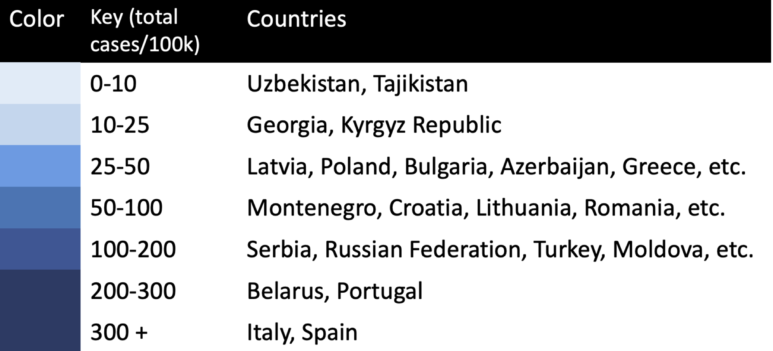
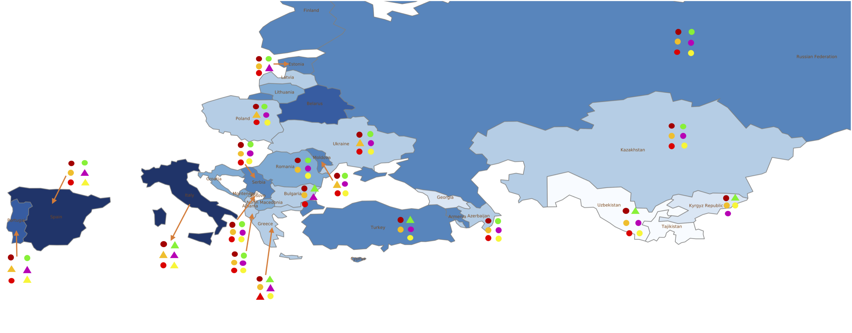
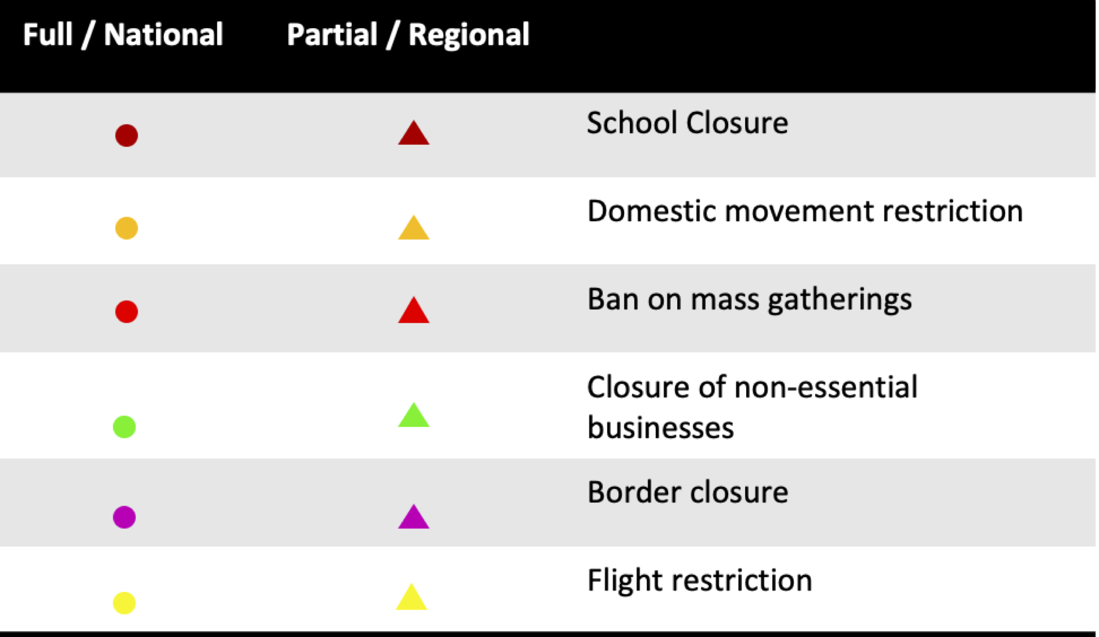
Public health and social measures implemented in the region
Italy is easing up its restrictions the most, followed by Greece and Portugal.
​
Russian Federation, ​Kazakhstan, Azerbaijan, Serbia, Kosovo and Albania have maximum restrictions.
Regions like Macedonia, Belarus, Lithuania, Georgia, and Latvia have missing data on their policy responses.
​

Slide 9
Countries and data sources
Albania | Georgia | Poland
Armenia | Greece | Portugal
Azerbaijan | Italy | Romania
Belarus | Kazakhstan | Russian Federation
Bulgaria | Kosovo | Serbia
Bosnia and Herzegovina | Kyrgyz Republic | Slovak Republic
Croatia | Latvia | Spain
Cyprus | Lithuania | Tajikistan
Czech Republic | Moldova | Turkey
Estonia | Montenegro | Turkmenistan (no cases)
Finland | North Macedonia | Ukraine
 |  | Uzbekistan
The monitor focuses on client countries in Europe and Central Asia with any lending or non-lending operation, and with available data, as in the Table.
In selected slides, comparator countries are presented, which are significant for their disease trajectories: Austria, United States, United Kingdom, and South Korea.
Data from:
Our World in Data, for data on cases, testing, deaths, and population size: https://ourworldindata.org/coronavirus.
World Health Organization, for data on public health and social measures: http://www.euro.who.int/en/health-topics/health-emergencies/coronavirus-covid-19

